Slide 1
A Brief Introduction to Machine Learning -- Part II
Contact : Jun Song Wang

Slide 2
What we learned in last class?

Slide 3
Mainly based on Stanford University Prof. Andrew Ng's Unsupervised Feature Learning and Deep Learning (UFLDL) online tutorial:
http://ufldl.stanford.edu/wiki/index.php/UFLDL_Tutorial
Thanks for Wei Shan Dong’s Lecture.

Slide 4
Outline
Neural Networks (NN) and BP
Autoencoder Neural Network
Softmax Regression
Self-Taught Learning
Deep Neural Network
CNN

Slide 5
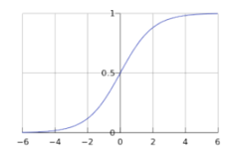

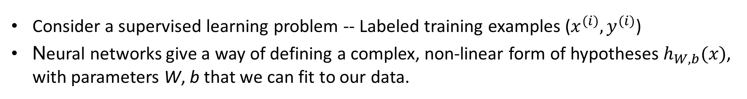



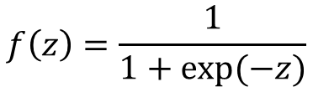

Neural Networks (NN)
Consider a supervised learning problem -- Labeled training examples ($x^{(i)}, y^{(i)}$)
Neural networks give a way of defining a complex, non-linear form of hypotheses $h_{W, b}(x)$, with parameters W, b that we can fit to our data.
$f\left(z\right):activation function$
$$f\left(z\right)=\frac{1}{1+exp⁡(−z)}$$
$$x_{1}$$
$$x_{2}$$
$$h_{W,b}(x)$$
$$x_{3}$$
+1
$$h_{W,b}(x)=f\left(W^{T}x\right)=f(w_{1}x_{1}+w_{2}x_{2}+w_{3}x_{3}+b)$$

Slide 6



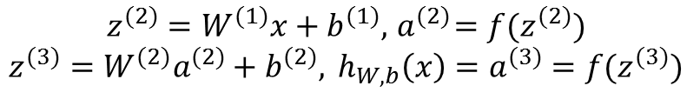



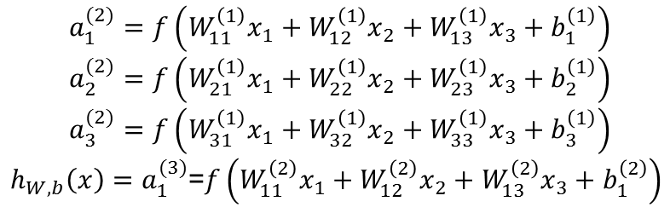


Neural Network Model and Forward Propagation
Put together by hooking together many simple "neurons," so that the output of a neuron can be the input of another.
$a_{i}^{(l)}$denotes the activation (output value) of unit i in layer l
$$a_{1}^{(2)}=f\left(W_{11}^{\left(1\right)}x_{1}+W_{12}^{\left(1\right)}x_{2}+W_{13}^{\left(1\right)}x_{3}+b_{1}^{\left(1\right)}\right)$$
$$a_{2}^{(2)}=f\left(W_{21}^{\left(1\right)}x_{1}+W_{22}^{\left(1\right)}x_{2}+W_{23}^{\left(1\right)}x_{3}+b_{2}^{\left(1\right)}\right)$$
$$a_{3}^{(2)}=f\left(W_{31}^{\left(1\right)}x_{1}+W_{32}^{\left(1\right)}x_{2}+W_{33}^{\left(1\right)}x_{3}+b_{3}^{\left(1\right)}\right)$$
$h_{W,b}\left(x\right)=a_{1}^{(3)}$=$f\left(W_{11}^{\left(2\right)}x_{1}+W_{12}^{\left(2\right)}x_{2}+W_{13}^{\left(2\right)}x_{3}+b_{1}^{\left(2\right)}\right)$
$$x_{1}$$
$$a_{1}^{(2)}$$
$$x_{2}$$
$$a_{2}^{(2)}$$
$$h_{W,b}\left(x\right)$$
$$a_{i}^{(l)}=f(z_{i}^{(l)})$$
$$x_{3}$$
$$a_{3}^{(2)}$$
Output layer
$$z^{(2)}=W^{(1)}x+b^{(1)}, { a}^{(2)}=f(z^{(2)})$$
$$z^{(3)}=W^{(2)}a^{(2)}+b^{(2)}, {{ h}_{W,b}\left(x\right)=a}^{(3)}=f(z^{(3)})$$
+1
+1
How to train the network?
Input layer
Hidden layer

Slide 7

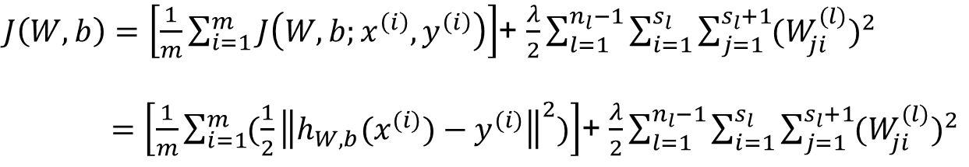

Firstly, define the cost/loss function…
Training dataset
Cost function to a single data
Minimize the overall cost function
[$\left(x^{\left(1\right)},y^{\left(1\right)}\right),\left(x^{\left(2\right)},y^{\left(2\right)}\right),…,\left(x^{\left(m\right)},y^{\left(m\right)}\right)$]
$$J\left(W,b;x,y\right)=\frac{1}{2}{\left\|h_{W,b}\left(x\right)−y\right\|}^{2}$$
$J\left(W,b\right)=\left[\frac{1}{m}\sum_{i=1}^{m}{J\left(W,b;x^{\left(i\right)},y^{\left(i\right)}\right)}\right]$+ $\frac{λ}{2}\sum_{l=1}^{n_{l}−1}{\sum_{i=1}^{s_{l}}{\sum_{j=1}^{s_{l}+1}{{(W_{ji}^{(l)})}^{2}}}}$
$=\left[\frac{1}{m}\sum_{i=1}^{m}{(\frac{1}{2}{\left\|h_{W,b}(x^{(i)})−y^{(i)}\right\|}^{2})}\right]$+ $\frac{λ}{2}\sum_{l=1}^{n_{l}−1}{\sum_{i=1}^{s_{l}}{\sum_{j=1}^{s_{l}+1}{{(W_{ji}^{(l)})}^{2}}}}$

Slide 8

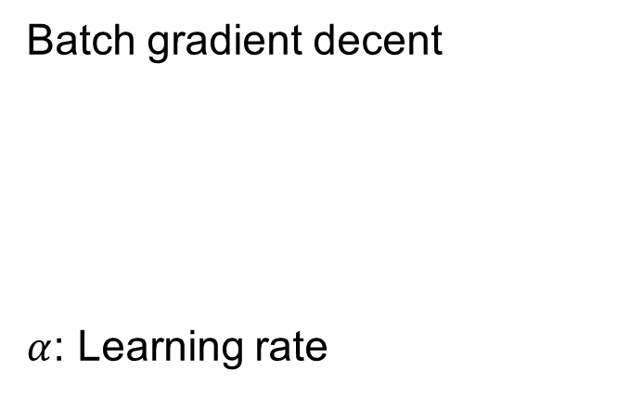
Secondly, Minimize it…
Batch gradient decent
$α$: Learning rate
$$W_{ij}^{(l)}=W_{ij}^{(l)}−α\frac{∂}{∂W_{ij}^{\left(l\right)}}J\left(W,b\right)$$
$$b_{i}^{(l)}=b_{i}^{(l)}−α\frac{∂}{∂b_{i}^{(l)}}J\left(W,b\right)$$
How to efficiently compute these partial derivatives?
Backpropagation (BP) algorithm

Slide 9
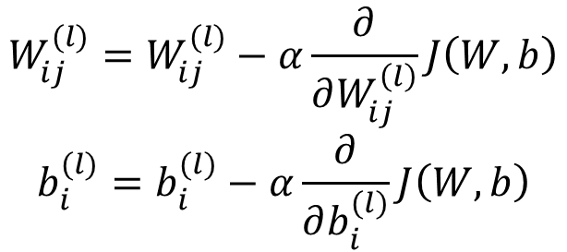
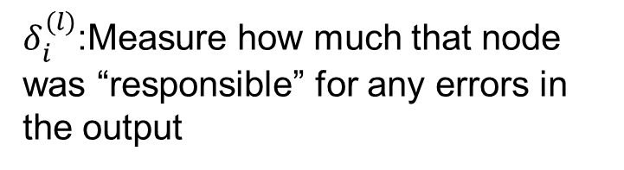
Backpropagation (BP) Algorithm
$$W_{ij}^{(l)}=W_{ij}^{(l)}−α\frac{∂}{∂W_{ij}^{\left(l\right)}}J\left(W,b\right)$$
$$b_{i}^{(l)}=b_{i}^{(l)}−α\frac{∂}{∂b_{i}^{(l)}}J\left(W,b\right)$$
$δ_{i}^{(l)}$:Measure how much that node was “responsible” for any errors in the output
http://ufldl.stanford.edu/wiki/index.php/Backpropagation_Algorithm

Slide 10

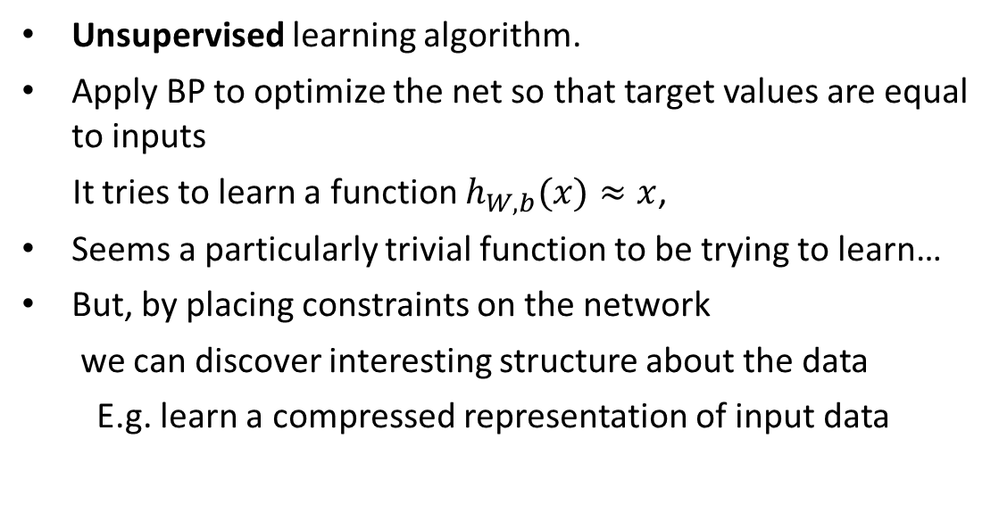







Autoencoder Neural Network
Unsupervised learning algorithm.
Apply BP to optimize the net so that target values are equal to inputs
It tries to learn a function $h_{W, b}(x)≈x$,
Seems a particularly trivial function to be trying to learn…
But, by placing constraints on the network
we can discover interesting structure about the data
E.g. learn a compressed representation of input data
$$x_{1}$$
$$\hat{x_{1}}$$
$$x_{1}$$
$$\hat{x_{2}}$$
$$h_{W,b}(x)$$
$$x_{1}$$
+1
$$\hat{x_{3}}$$
Sparsity Constraint
Think of a neuron (assuming a sigmoid activation function)
as being "active" if its output value is close to 1
as being "inactive" if its output value is close to 0
We’d like to constrain neurons to be inactive most of the time
Activation becomes sparse in the network
+1
$$\hat{x_{4}}$$

Slide 11
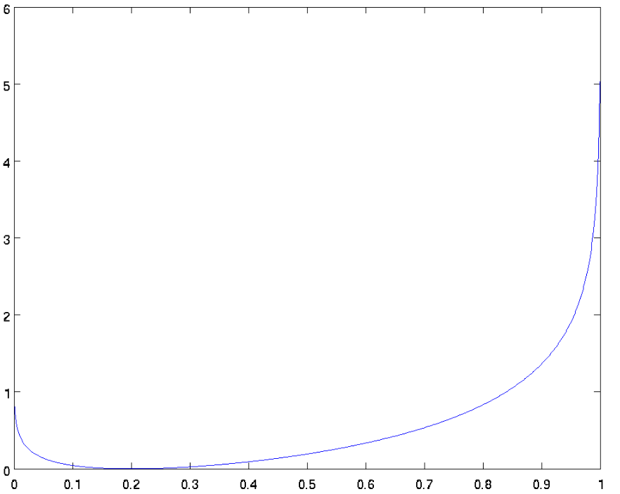
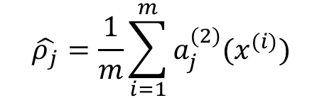

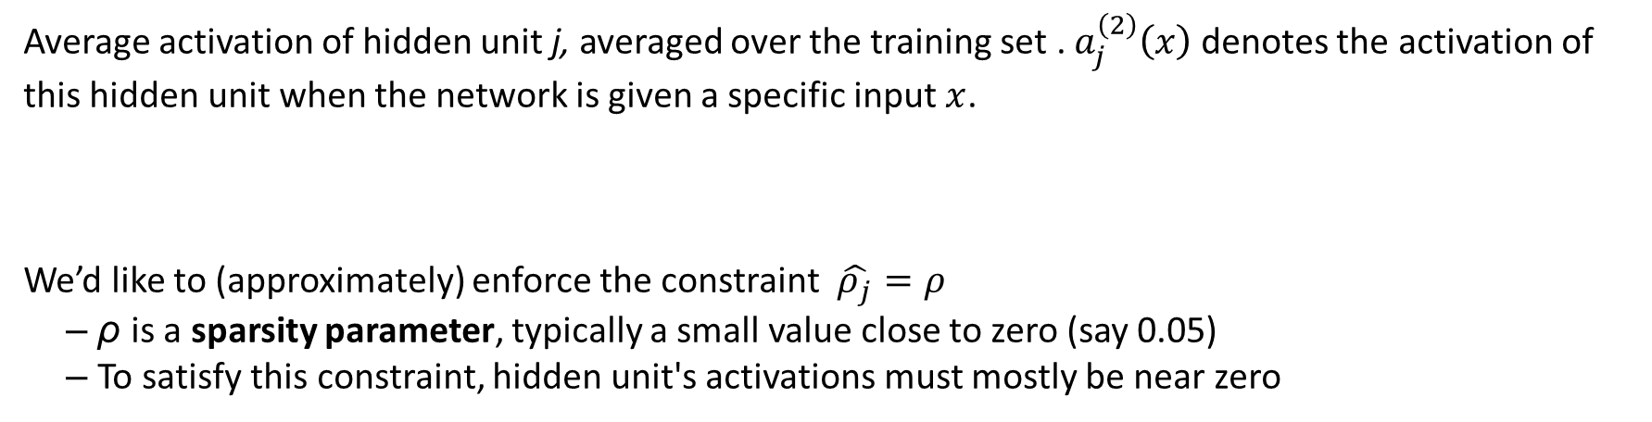
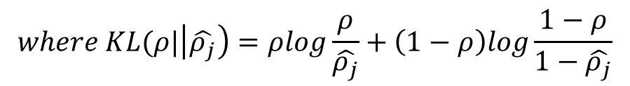
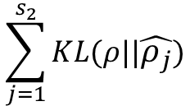
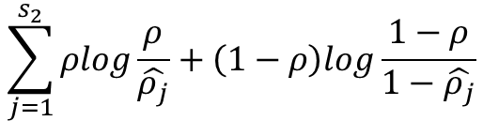

Mathematically
Average activation of hidden unit j, averaged over the training set . $a_{j}^{\left(2\right)}\left(x\right)$ denotes the activation of this hidden unit when the network is given a specific input$x$.
We’d like to (approximately) enforce the constraint $\hat{ρ_{j}}=ρ$
– ρ is a sparsity parameter, typically a small value close to zero (say 0.05)
– To satisfy this constraint, hidden unit's activations must mostly be near zero
$$\hat{ρ_{j}}=\frac{1}{m}\sum_{i=1}^{m}{a_{j}^{(2)}{(x}^{(i)})}$$
$$ρ=0.2$$
A typical form: summing over the hidden units in network
$$\sum_{j=1}^{s_{2}}{ρlog\frac{ρ}{\hat{ρ_{j}}}+\left(1−ρ\right)log\frac{1−ρ}{1−\hat{ρ_{j}}}}$$
In fact, it is the Kullback-Leibler (KL) divergence between a Bernoulli random variable with mean ρ and a Bernoulli random variable with mean
$$\hat{ρ_{j}}$$
$$\sum_{j=1}^{s_{2}}{KL(ρ||\hat{ρ_{j}})}$$
$$where KL(ρ|\left|\hat{ρ_{j}}\right)=ρlog\frac{ρ}{\hat{ρ_{j}}}+\left(1−ρ\right)log\frac{1−ρ}{1−\hat{ρ_{j}}}$$

Slide 12
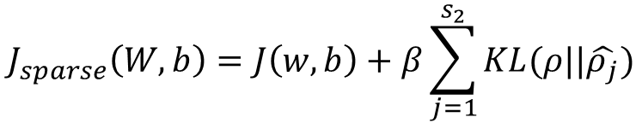
Cost Function of Autoencoder
• The overall cost function with adding the sparsity penalty:
• Then, we can use BP to train an autoencoder.
$$J_{sparse}\left(W,b\right)=J\left(w,b\right)+β\sum_{j=1}^{s_{2}}{KL(ρ||\hat{ρ_{j}})}$$
Compressed representation (or say, features)
Visually…
• Suppose an autoencoder with 100 hidden units
–One image per hidden unit
• Different hidden units have learned to detect edges
–at different positions and orientations in the image
• These features are useful for object recognition and other vision tasks

Slide 13
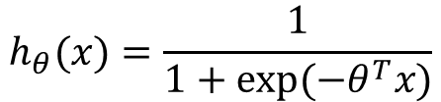
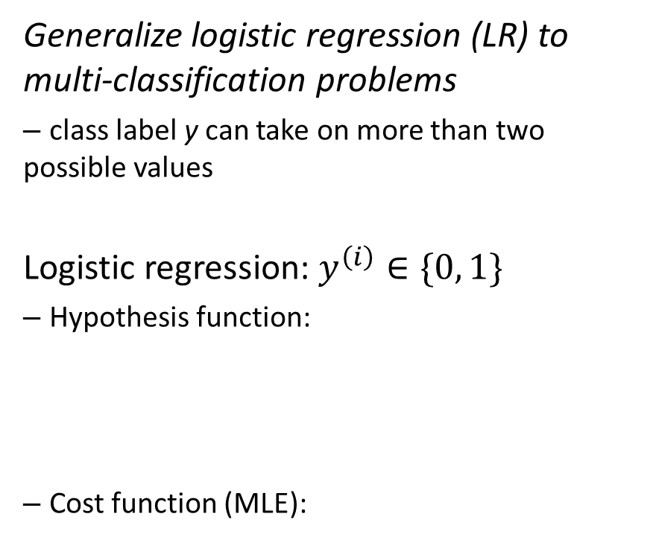
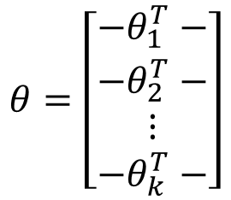
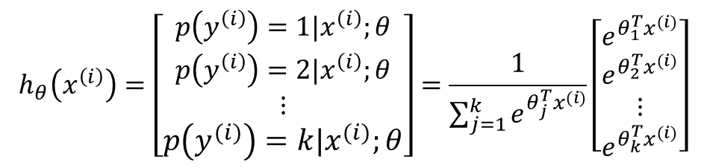
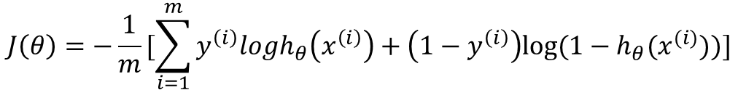
Softmax Regression
Hypothesis function:
–Output is a vector: estimate the probability that p(y=j|x) for each value of j=1, …, k
Let’s use θ to denote all the parameters of softmax model
Generalize logistic regression (LR) to multi-classification problems
– class label y can take on more than two possible values
Logistic regression: $y^{\left(i\right)}∈\{0, 1\}$
– Hypothesis function:
– Cost function (MLE):
$$h_{θ}\left(x^{\left(i\right)}\right)=\left[\begin{aligned}p\left(y^{\left(i\right)}\right)=1|x^{\left(i\right)};θ \\ p\left(y^{\left(i\right)}\right)=2|x^{\left(i\right)};θ \\ ⋮ \\ p\left(y^{\left(i\right)}\right)=k|x^{\left(i\right)};θ\end{aligned}\right]=\frac{1}{\sum_{j=1}^{k}{e^{θ_{j}^{T}x^{(i)}}}}\left[\begin{aligned}e^{θ_{1}^{T}x^{(i)}} \\ e^{θ_{2}^{T}x^{(i)}} \\ ⋮ \\ e^{θ_{k}^{T}x^{(i)}}\end{aligned}\right]$$
$$h_{θ}(x)=\frac{1}{1+exp⁡(−θ^{T}x)}$$
$$θ=\left[\begin{aligned}−θ_{1}^{T}− \\ −θ_{2}^{T}− \\ ⋮ \\ −θ_{k}^{T}−\end{aligned}\right]$$
$$J\left(θ\right)=−\frac{1}{m}[\sum_{i=1}^{m}{y^{\left(i\right)}logh_{θ}\left(x^{\left(i\right)}\right)+\left(1−y^{\left(i\right)}\right)log⁡(1−h_{θ}(x^{(i)}))}]$$

Slide 14
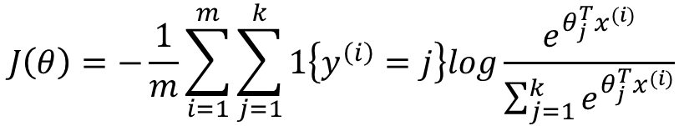
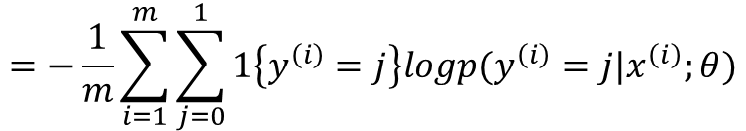
Cost function
• Cross entropy:
–It is the generalization of LR cost function:
• No known closed-form way to minimize J(θ)
–Iterative optimization algorithm such as gradient descent or L-BFGS
–But, minimizer of J(θ) is not unique!
$$J\left(θ\right)=−\frac{1}{m}\sum_{i=1}^{m}{\sum_{j=1}^{k}{1\left\{y^{\left(i\right)}=j\right\}log\frac{e^{θ_{j}^{T}x^{(i)}}}{\sum_{j=1}^{k}{e^{θ_{j}^{T}x^{(i)}}}}}}$$
$$J\left(θ\right)=−\frac{1}{m}[\sum_{i=1}^{m}{y^{\left(i\right)}logh_{θ}\left(x^{\left(i\right)}\right)+\left(1−y^{\left(i\right)}\right)log⁡(1−h_{θ}(x^{\left(i\right)}))}]$$
$$=−\frac{1}{m}\sum_{i=1}^{m}{\sum_{j=0}^{1}{1\left\{y^{\left(i\right)}=j\right\}logp(y^{\left(i\right)}=j|x^{\left(i\right)};θ)}}$$

Slide 15
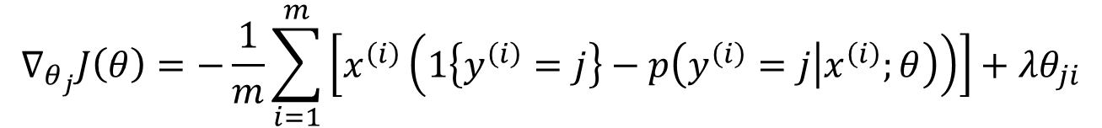
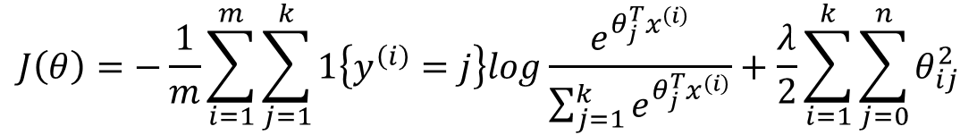
Cost function (cont’d)
• Adding a weight decay term
• J(θ) is now strictly convex, and is guaranteed to have a unique solution
–algorithms such as gradient descent, L-BFGS, etc. are guaranteed to converge to the global minimum
$$J\left(θ\right)=−\frac{1}{m}\sum_{i=1}^{m}{\sum_{j=1}^{k}{1\left\{y^{\left(i\right)}=j\right\}log\frac{e^{θ_{j}^{T}x^{\left(i\right)}}}{\sum_{j=1}^{k}{e^{θ_{j}^{T}x^{\left(i\right)}}}}}}+\frac{λ}{2}\sum_{i=1}^{k}{\sum_{j=0}^{n}{θ_{ij}^{2}}}$$
$$∇_{θ_{j}}J\left(θ\right)=−\frac{1}{m}\sum_{i=1}^{m}{\left[x^{\left(i\right)}\left(1\left\{y^{\left(i\right)}=j\right\}−p\left(y^{\left(i\right)}=j | x^{\left(i\right)};θ\right)\right)\right]}+λθ_{ji}$$

Slide 16
Softmax Regression vs. k Binary Classifiers
• Should you use s softmax classifier, or should you build k separate binary classifiers using LR?
• Depend on whether the classes are mutually exclusive
– If each training example is labeled with exactly one class label: Softmax
– Otherwise: k LR
Consider a computer vision example…
If classify images into 3 different classes:
I. indoor_scene, outdoor_urban_scene, and outdoor_wilderness_scene
Use softmax
II.indoor_scene, black_and_white_image, and image_has_people
Use LR

Slide 17
Break

Slide 18


Self-Taught Learning
1. Learn a good feature representation from a large amount of unlabeled data.
2. Take the learned feature representation and whatever (perhaps small amount of) labeled data we have, apply supervised learning on labeled data.
Replacement and Concatenation Representations
• Labeled training set
• Replacement representation:
• Concatenation representation:
[$\left(x^{\left(1\right)},y^{\left(1\right)}\right),\left(x^{\left(2\right)},y^{\left(2\right)}\right),…,\left(x^{\left(m\right)},y^{\left(m\right)}\right)$]
[$\left(a^{\left(1\right)},y^{\left(1\right)}\right),\left(a^{\left(2\right)},y^{\left(2\right)}\right),…,\left(a^{\left(m\right)},y^{\left(m\right)}\right)$]
[$\left({(x}^{\left(1\right)},a^{(1)}), y^{\left(1\right)}\right),\left({(x}^{\left(2\right)},{a^{(2)}), y}^{\left(2\right)}\right),…,\left({(x}^{\left(m\right)},a^{(m)}),y^{\left(m\right)}\right)$]

Slide 19
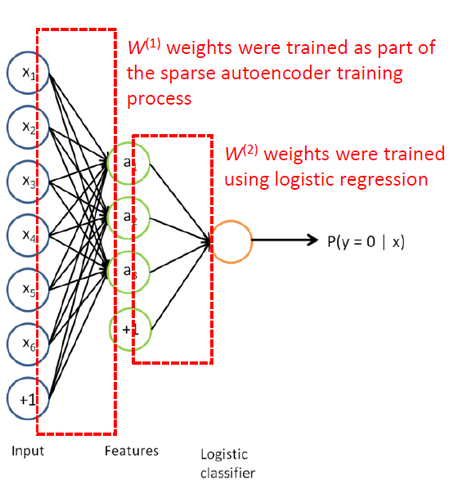
STL and Fine-tuning
• In STL framework, we can use a sparse autoencoder to learn features, and feed them as inputs to a softmax/logistic regression classifier
– Features are learned using only unlabeled data
Fine-tuning: Further improve the learned features.
• Further modify all the parameters in the network, i.e., weights on all layers, to try to further reduce training error on labeled training set
–Perform gradient descent from the current setting of the parameters
–Labeled data can be used to modify W(1) as well, so that adjustments can be made to the features
• The original learning steps (i.e., training the autoencoder and the logistic classifier) are called pre-training

Slide 20
Deep Neural Network Overview
Deep neural networks: multiple hidden layers
Each hidden layer computes a non-linear transformation of the previous layer, so a deep network can have significantly greater representational power than a shallow one, which can learn significantly more complex functions
Key: Non-linear Activation Function
Because multiple layers of linear functions would itself compute only a linear function of the input. Composing multiple linear functions together results in just another linear function
Advantages of Deep Networks
Can compactly represent a significantly larger set of functions than shallow networks. Formally, one can show that there are functions which a k-layer network can represent compactly (with a number of hidden units that is polynomial in the number of inputs), that a (k − 1)-layer network cannot represent unless it has an exponentially large number of hidden units

Slide 21
In the case of images…
Deep networks can learn part-whole decompositions

Slide 22
Difficulty of Training Deep Architectures
• Availability of data
labeled data is often scarce
• Local optima
training with gradient descent no longer work well
• Diffusion of gradients
when using gradient descent, the weights of earlier layers change slowly,
and the earlier layers fail to learn much
• How can we train a deep network?

Slide 23
Greedy Layer-wise Training
• Train the layers of the network one at a time, Stacked Autoencoders
• Availability of data
– Unlabeled data is cheap and plentiful
– STL: By using unlabeled data to learn a good initial value for the weights in all the
layers (except for the final classification layer)
• Better local optima
– After having trained the network on the unlabeled data, the weights are now starting at
a better location in parameter space than if they had been randomly initialized
– Empirically, gradient descent from this location (fine-tuning) is much more likely to lead
to a good local minimum
• Unlabeled data has already provided a significant amount of "prior" information about what patterns there are in the input data.

Slide 24
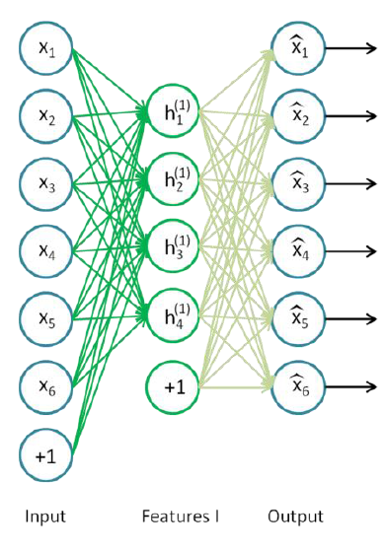
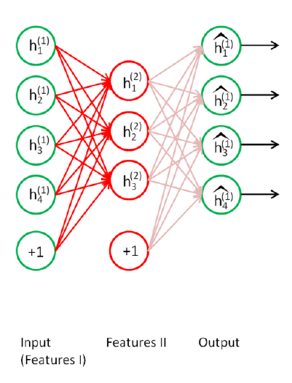
Stacked Autoencoders (1):
Learn First-order Features
Stacked Autoencoders (2):
Learn Second-order Features
http://ufldl.stanford.edu/wiki/index.php/Stacked_Autoencoders

Slide 25
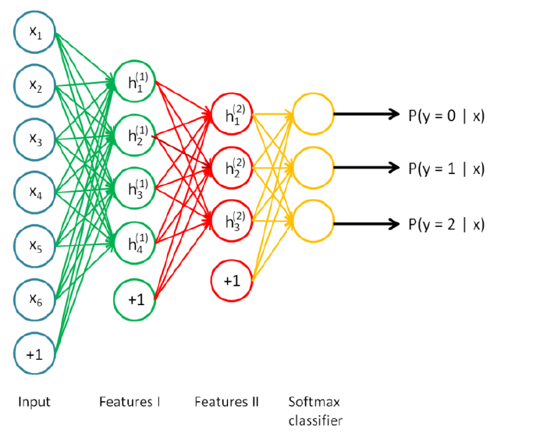
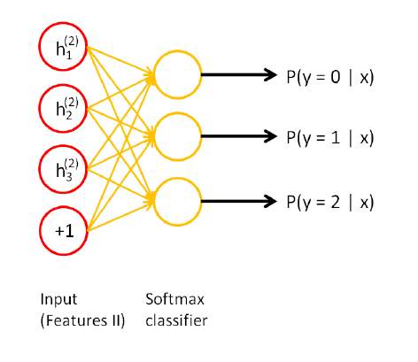
Stacked Autoencoders (3):
Map Secondary Features to Labels
Stacked Autoencoders (4):
Combine All Layers
http://ufldl.stanford.edu/wiki/index.php/Stacked_Autoencoders

Slide 26
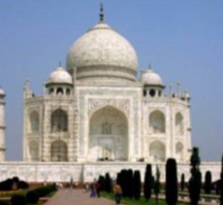
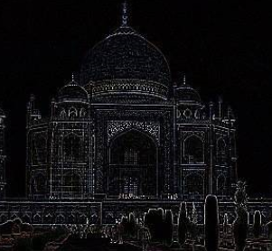
What is Convolution?
1 | 1 | 1
1 | 1 | 1
1 | 1 | 1
0 | 1 | 0
1 | -4 | 1
0 | 1 | 0
Convolve the learned features (or say “filter”) with the larger image to obtain a different feature activation value at each location in the image
http://mp.weixin.qq.com/s?__biz=MzA4Mzc0NjkwNA==&mid=400578686&idx=1&sn=a7249b2887cb9efbc9b977bb075cf460&scene=0#wechat_redirect

Slide 27
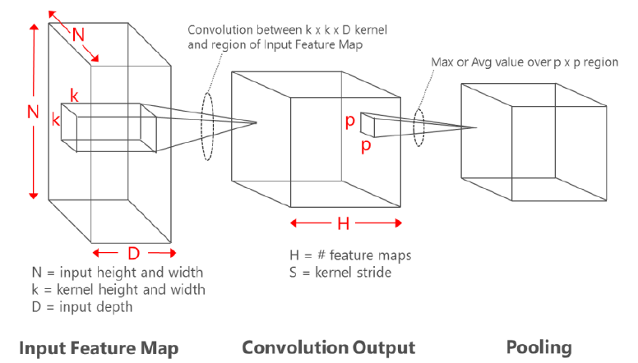
What is 3D Convolution?
Accelerating Deep Convolutional Neural Networks Using Specialized Hardware
Kalin Ovtcharov, Olatunji Ruwase, Joo-Young Kim, Jeremy Fowers, Karin Strauss, Eric S. Chung Microsoft Research

Slide 28
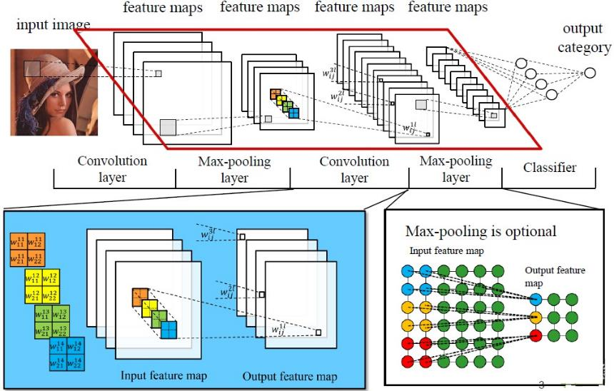
Deep Convolutional Neural Networks
Convolve the learned features (or say “filter”) with the larger image to obtain a different feature activation value at each location in the image
Chen Zhang, Optimizing FPGA-based Accelerator Design for Deep Convolutional Neural Networks

Slide 29
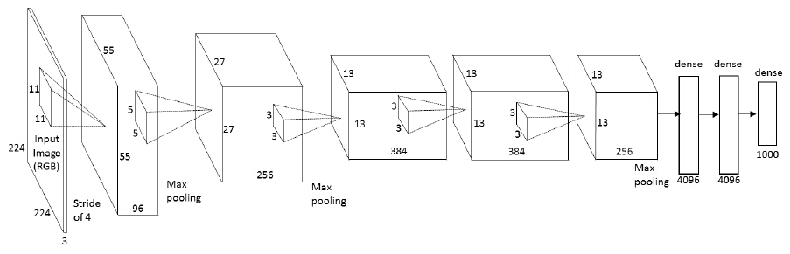
Many tricks!
Initialization of weights
Selection of activation functions
#layers and #feature maps
Filter size & shape, pooling shape …
Imagenet classification with deep convolutional neural networks

Slide 30
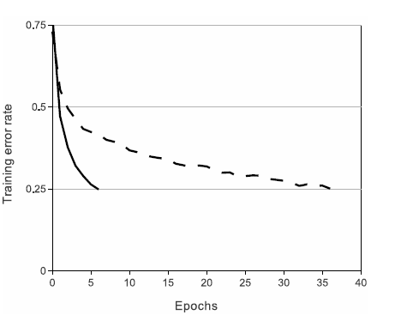
Dropout
Setting to zero the output of each hidden neuron with probability 0.5. The neurons which are
“dropped out” in this way do not contribute to the forward pass and do not participate in backpropagation.
This technique reduces complex co-adaptations of neurons, since a neuron cannot rely on the presence of particular other neurons..
We use dropout in the first two fully-connected layers.
Dropout roughly doubles the number of iterations required to converge.
ReLU Nonlinearity
A four-layer convolutional neural network with ReLUs (solid line) reaches a 25% training error rate on CIFAR-10 six times faster than an equivalent network with tanh neurons (dashed line).
Ref. Imagenet classification with deep convolutional neural networks

Slide 31
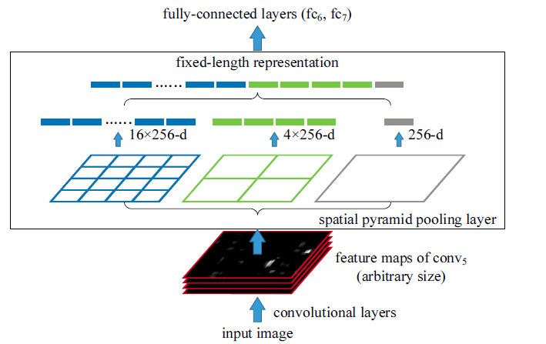
Spatial Pyramid Pooling
Spatial Pyramid Pooling in Deep Convolutional

Slide 32
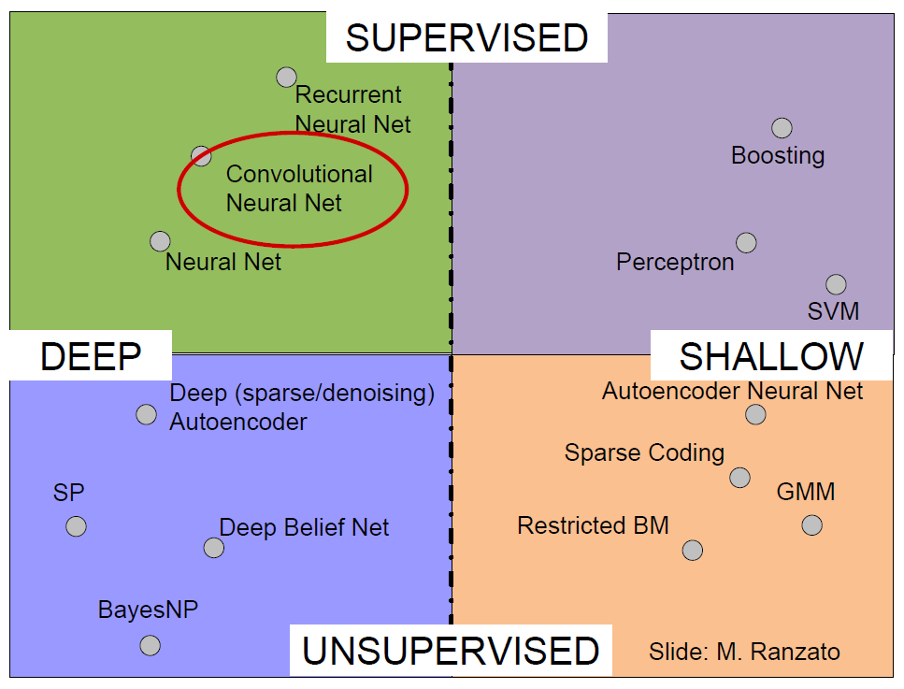
Object Detection
with Deep Learning
CVPR 2014 Tutorial
Pierre Sermanet, Google Research

